Slide 1





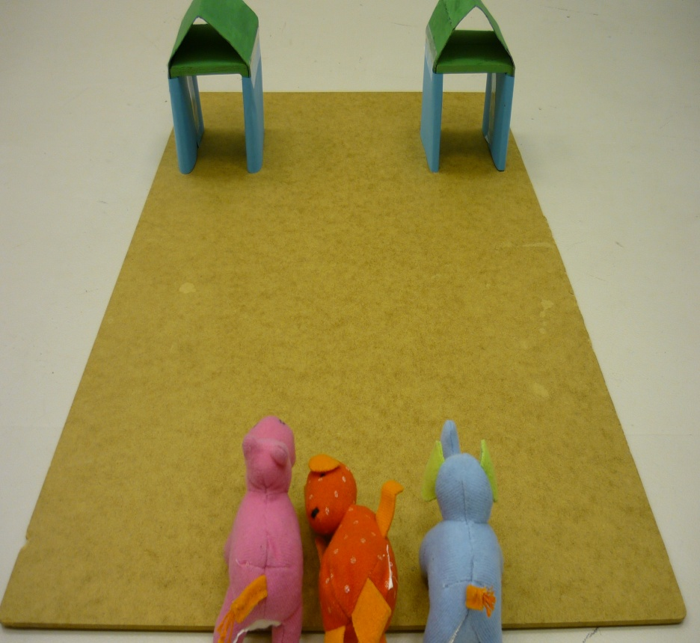
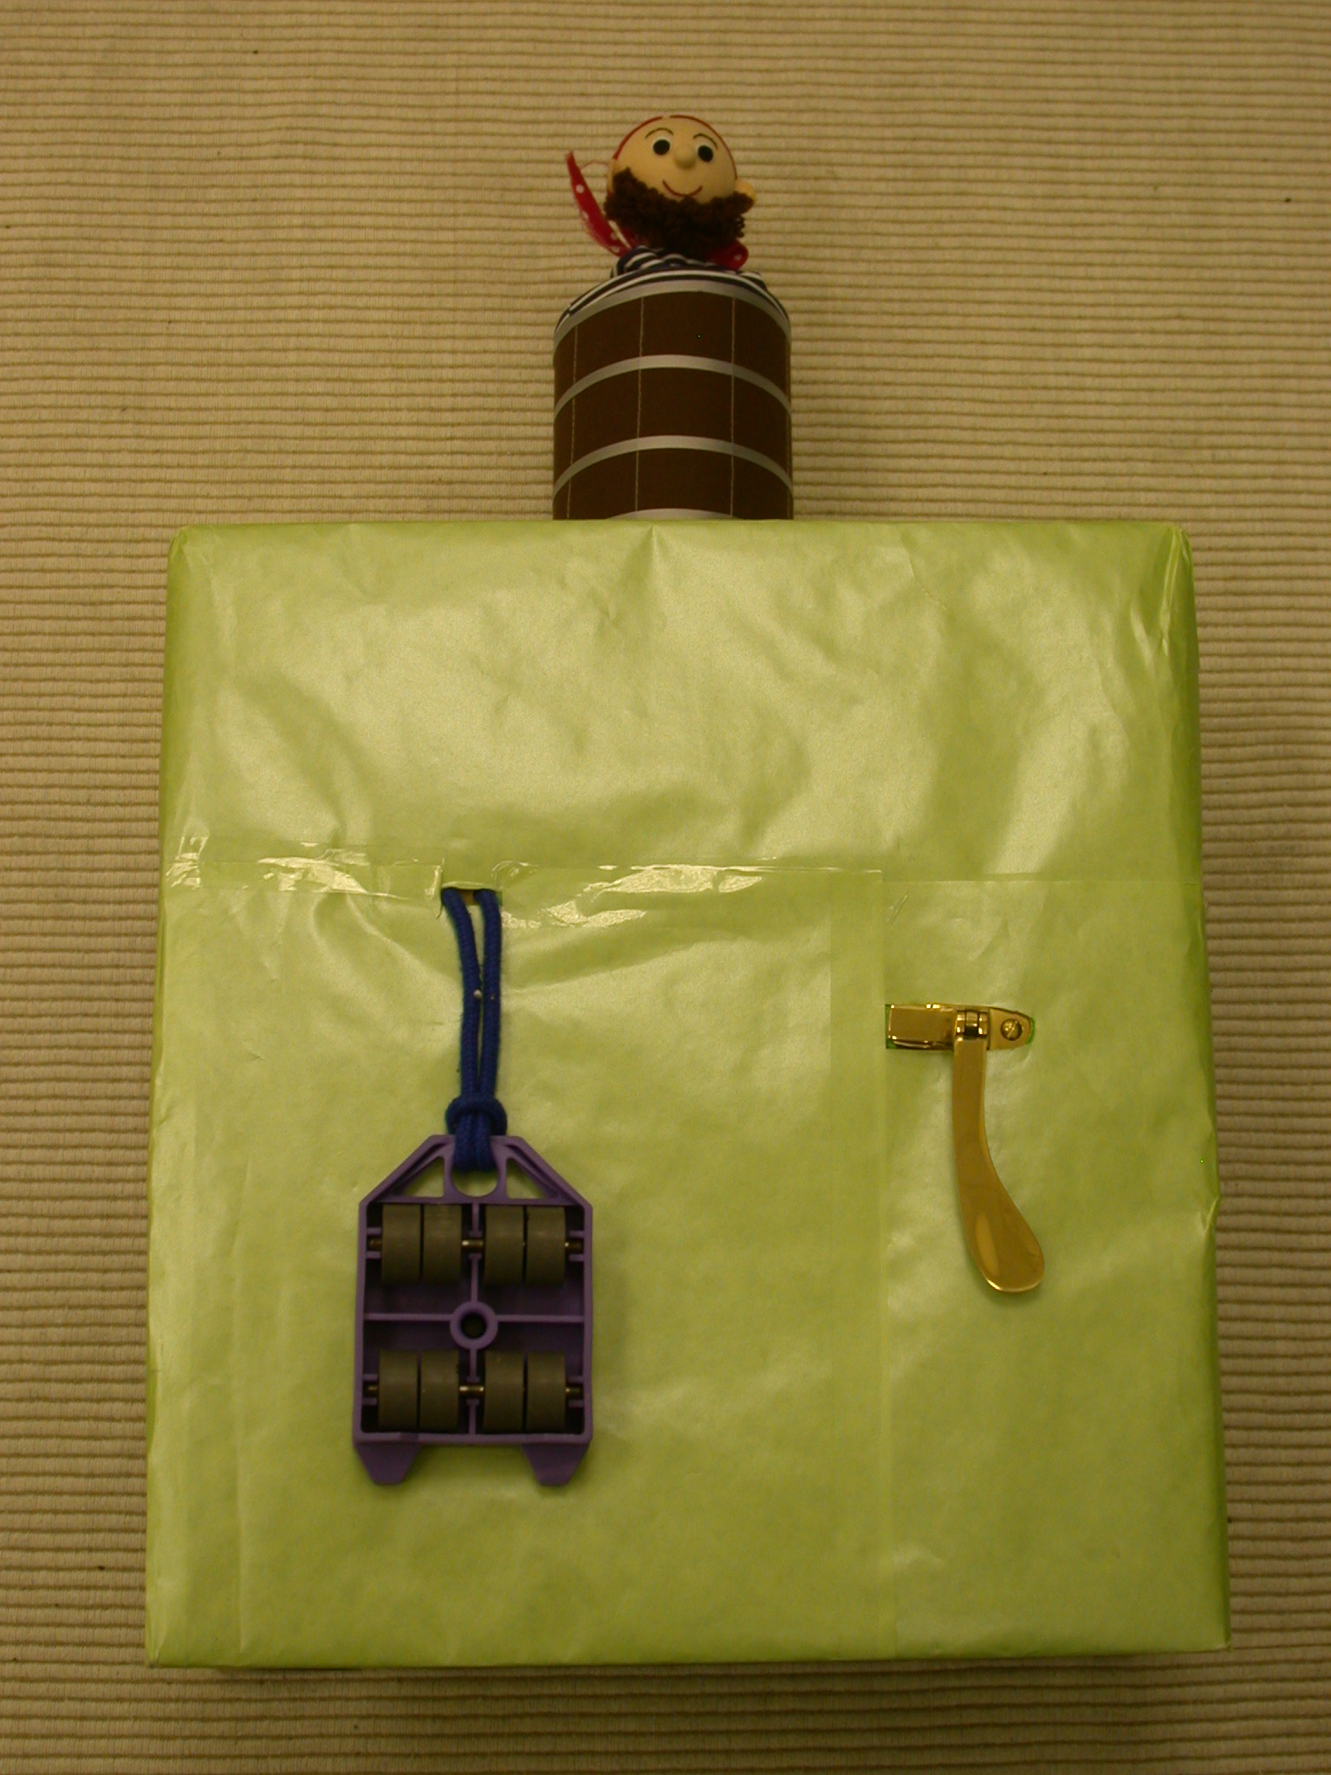
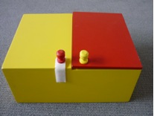
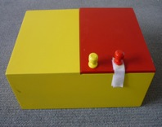
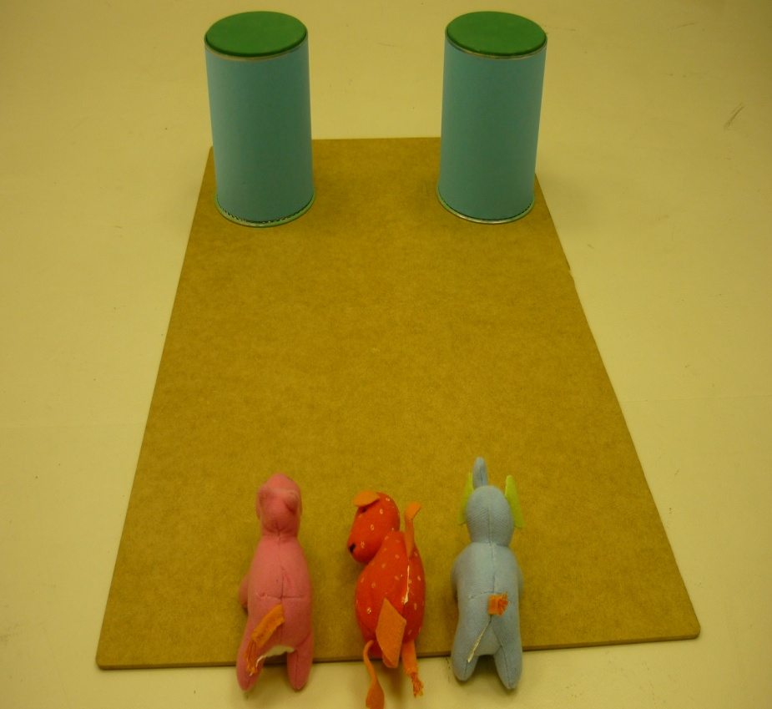
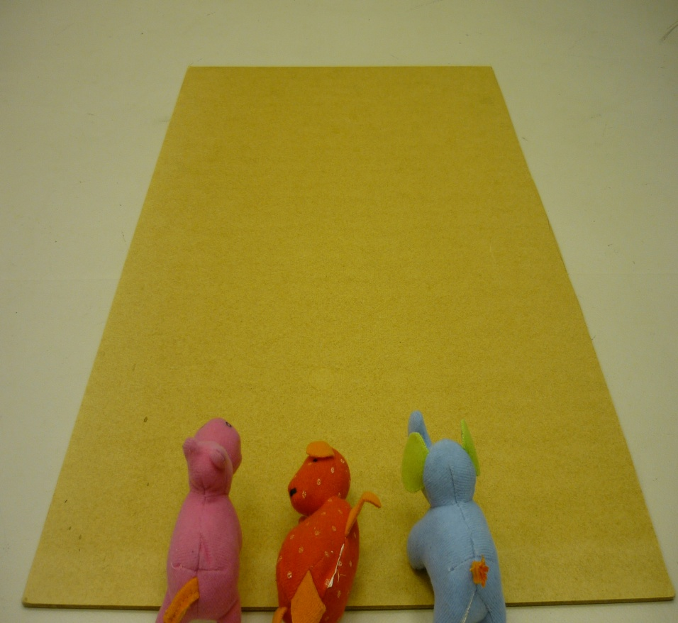
Selective and Faithful Imitation Assessed
Longitudinally From 13 to 24 Months
Elena Sakkalou^{1, 2}, Kate Ellis-Davies^{3,2}, Elma Hilbrink^{4,2}, Merideth Gattis²
¹UCL Institute of Child Health, UK ²Cardiff University, UK
³Cambridge University, UK ⁴Max Planck Institute for Psycholinguistics, NL
  Background
  Aims
  Examine the development of goal-directed and faithful imitation through a longitudinal sample using the same task and same children across time.
  Examine mechanisms that underlie the developmental progression in faithful imitation by testing the Interpersonal / social motivation account.
  Hypotheses
  1) Goal-directed and faithful imitation will increase across the second year.
  2) Infants will show stability in goal-directed and faithful imitation across ages.
  3) Highly social infants will produce more faithful imitation.
  Materials
Methods
Participants: 37 infants tested longitudinally at 13, 17 and 24 months.
Imitation task: Adapted from Carpenter et al. (2005). In a within-subjects design, an adult experimenter moved a toy animal across a flat surface in a hopping manner towards a final location.
Coding goal-directed imitation: Number of times infants placed animal in final location in the OBJECT CONDITIONS or hopped animal in the NO-OBJECT CONDITION (see figure below left).
Coding faithful imitation: Number of irrelevant aspects copied, which were not the primary goal of the demonstration. Types of irrelevant aspects:
  Same Animal
  Same Vocalization
  Same exact location (left or right)
  Hopping in Object Conditions or Final Location in No-Object Condition
Extraversion: Measured at 15 months through the Surgency/Extraversion scale of the Early Childhood Behavior Questionnaire (Putnam et al, 2006).
Results
Faithful Imitation and Relation with Extraversion
12 month-olds imitate the perceived goal of a demonstration.
Goal-directed imitation is a stable trait – infants imitate goals across dissimilar tasks (Sakkalou, Ellis-Davies, Fowler, Hilbrink & Gattis, 2013).
Mean Faithful Imitation
*
*
*
*
High-Extraversion
Low-Extraversion
15-month-olds imitate faithfully - copy unnecessary steps in an action sequence, or over-imitate.
Faithful imitation is related to infant extraversion. More extraverted infants imitated more faithfully (Hilbrink, Sakkalou, Ellis-Davies, Fowler, & Gattis, in press).
13 Months 17 Months 24 Months
Goal-Directed Imitation Correlation
Faithful Imitation Correlation
17 Months
17 Months
ρ =.39
p < .02
ρ =.57
p < .001
ρ =.38
p < .02
ρ =.27
p = .11
13 Months 24 Months
13 Months 24 Months
Conclusions
Imitation of goals increases steadily and remains a stable trait of infants across the second year of life. The findings support previous work in our lab (Sakkalou et al., 2013).
Faithful imitation also increases steadily but reflects less individual stability across the ages tested.
Infants high in extraversion made a significant shift towards faithful imitation earlier than infants low in extraversion.
These results support previous work in our lab (Hilbrink et al, in press) suggesting that the shift to more faithful imitation is related to social and interpersonal motivations (Uzgiris, 1981).
Goal-Directed Imitation
*
Mean Goal-directed Imitation
References
Carpenter, M., Call, J., & Tomasello, M. (2005). Twelve- and 18-month-olds copy actions in terms of goals. Developmental Science, 8, 13-20.
Putnam, S. P., Gartstein, M. A., & Rothbart, M. K. (2006). Measurement of fine-grained aspects of toddler temperament: The early childhood behavior questionnaire. Infant Behavior and Development, 29, 386-401.
Sakkalou, E., Ellis-Davies, K., Fowler, N. C., Hilbrink, E. E., & Gattis, M. (2013). Infants show stability of goal-directed imitation. Journal of Experimental Child Psychology. 114,1-9.
Hilbrink, E. E., Sakkalou, E., Ellis-Davies, K., Fowler, N. C., & Gattis, M (in press). Selective and Faithful Imitation at 12- and 15-Months. Developmental Science.
OBJECT CONDITIONS
NO-OBJECT CONDITION
Selective Selective Selective
13 Months 17 Months 24 Months
Notes:
1

